Slide 1

STAR BANK MANAGEMeNT SYSTEM

Slide 2
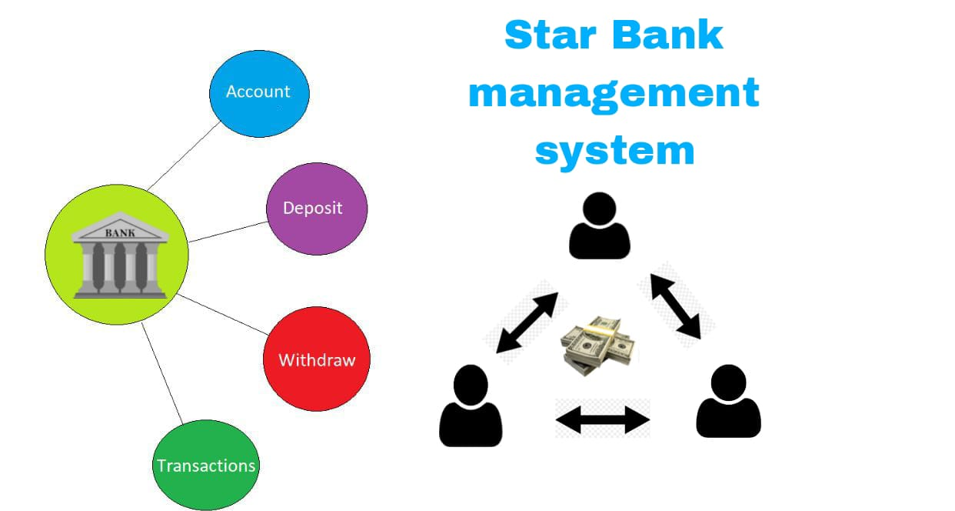
Introduction
Banking Management is a software for solving financial applications of a user in banking environment in order to nature the needs of an end banking admin by providing various ways to perform banking tasks .
The bank management system is an application for maintaining a users account in a bank the system provides the access to the user to create an account , to login in an account , to check the balance and for changing the password. The access to the admin is to deposit withdraw transfer the cash from user account .

Slide 3

Requirements
Functional Requirements
Non functional Requirements
Technical Requirements

Slide 4
Functional requirements
Account opening can be done by entering aadhar no and this number should be used as an account number. Every aadhar no. entered should be unique.
During account opening the customer maintains minimum balance for SA 5000 and CA 10000.
During account opening the customer need to choose his password which will be used at the time of login.
After login the customer is also allowed to change his password.
If the balance is <=Minimum balance the withdrawl transaction should not be allowed.
Ensure proper validation across all entries.

Slide 5
Non functional requiremnets
Multi-file multi-directory solution is expected. Modular and maintainable code (comments) and all coding standards should be followed.
makefile to build application. Two-step compilation process - .o and then executable should be generated.
Use valgrind tool on application executable to detect memory leak. Final valgrind report to be submitted in “reports” directory.
use ctags tool to navigate between the files
Level 0 DFD (context diagram), Level 1 DFD, Flow diagram and pseudocode for 2 complex functions logic.
RTM, Plan, Presentation

Slide 6
Technical Requirements
C programming language
Use file input output operations to read and write the customer and transaction details
Use data structure of your choice and dynamic memory allocation for all operations

Slide 7
start
Flow chart
User
Admin
Create account
Login
SA
CA
Login
Withdraw
Deposit
Transfer
Check balance
Change password

Slide 8
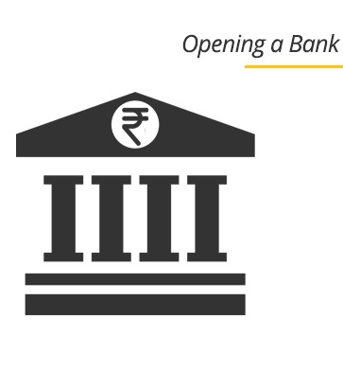
Create account
To create/open the account user should fill some details
They are
Account number( 13 numbers)
User name(must be char)
Password(must be char)
Need to choose SA OR CA
For SA min balance is 5000
For CA min balance is 10000
After entering details correctly user can able to open the bank account

Slide 9
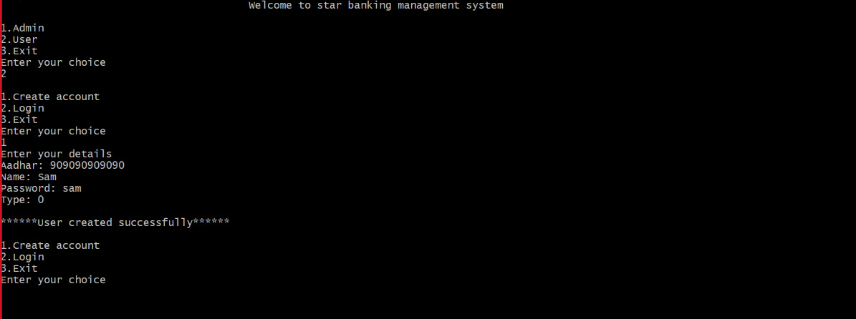

Slide 10
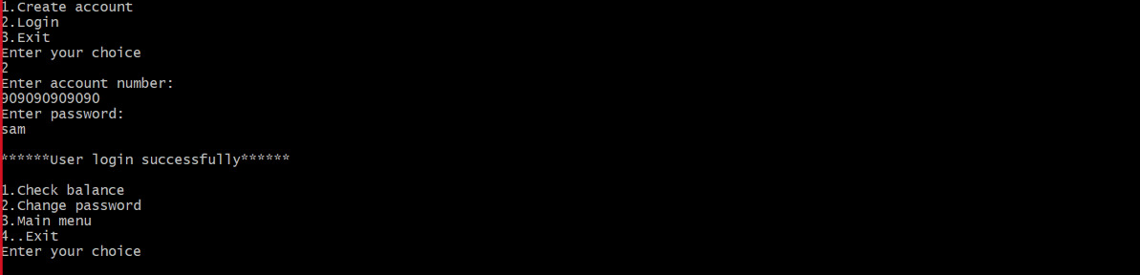
User login
To login into user account user need to enter password and account number that should match the detials with is used in create account.
If the password and account number matches then user can access to the following details such as:
Check balance
Change password

Slide 11
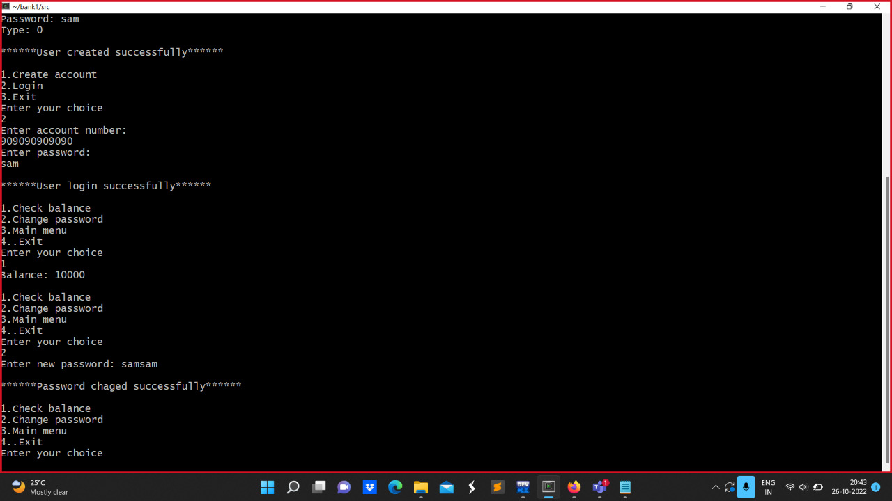
Check balance
Change Password

Slide 12
ADmin login
For admin login you should enter the admin id and password
If the admin id password matches then you admin has an access to the following details:
With draw money from the user account
Deposit money to the user account
Transfer money from one account to another

Slide 13
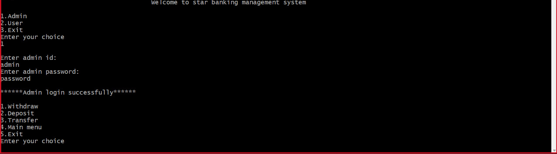

Slide 14
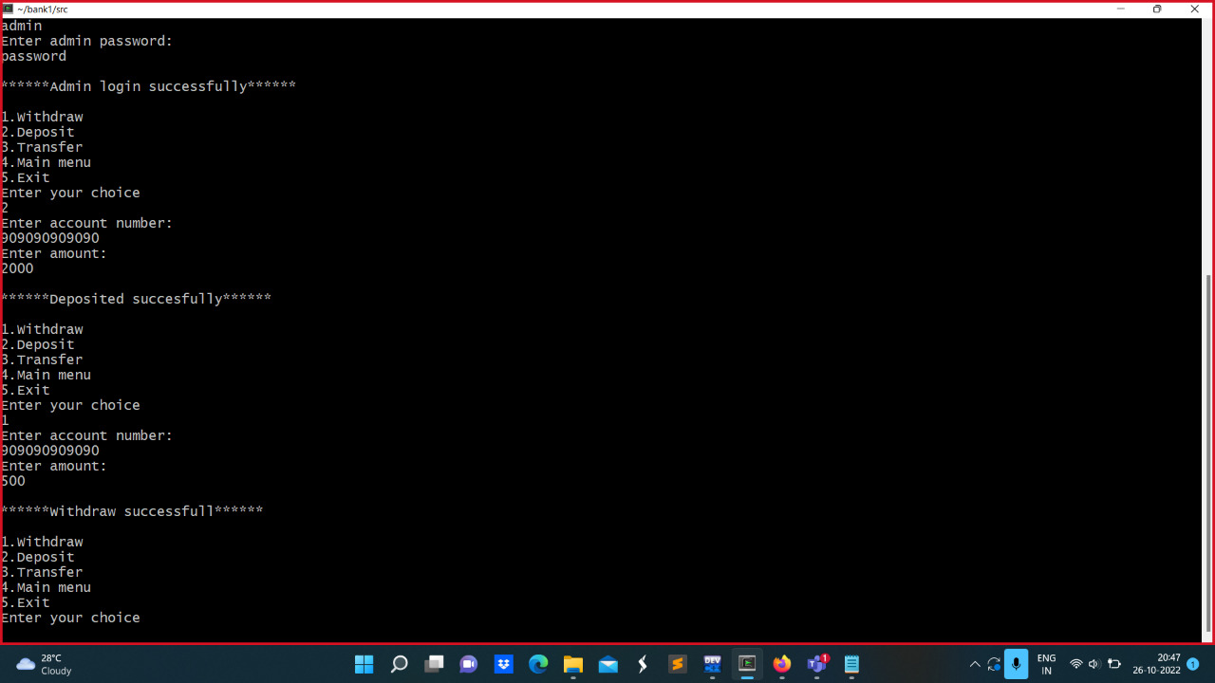
With draw money
To with draw money for the user employee need to enter account number and money that account number should be valid.
Then With draw successfully done.
And money is debited from the user account.

Slide 15
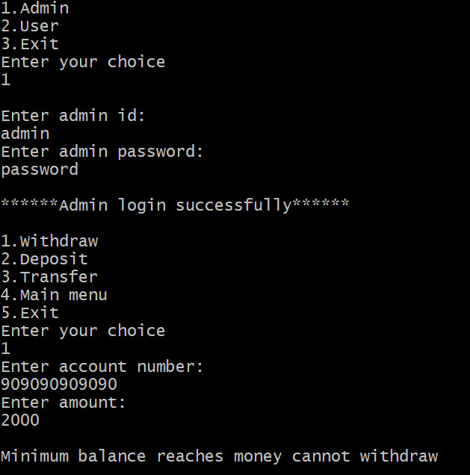
Note:
If the min balance reaches money cannot be withdrawn
For SA min balance is 5000
For CA min balance is 10000

Slide 16
Deposit money
To deposit money to the user employee should enter user account number and money.
And the money is added to user account.
Then deposit is successfully done.

Slide 17
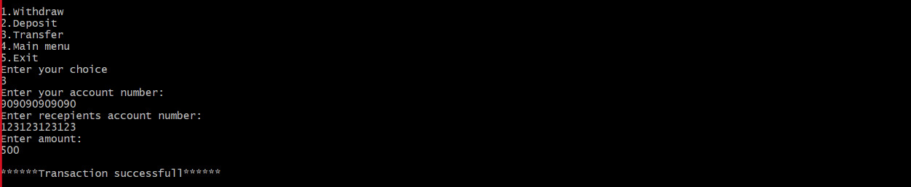
Transfer money
To transfer money from one account to another account you need to enter two account numbers correctly and need to enter the money then amount will transfer from one account to another.
Then transaction done successfully.

Slide 18
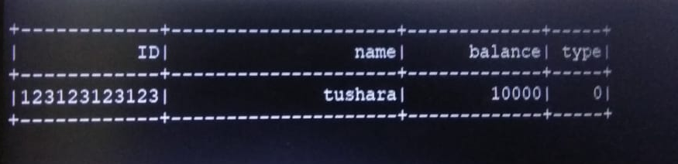
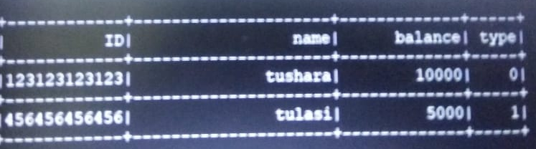
records
Only one user record
All user records access for only admin

Slide 19
List of functions
void update_file() (to update the data in file)
int transfer() ( to transfer)
int debit() (to debit the money)
int credit() (to credit the money)
User *create_user() (to create user account)
User *user_register() (to login)
int change_password() ( to change password for the user)
int is_user() (for user)
int is_admin() (for admin)
User *find_user() (find the user)

Slide 20
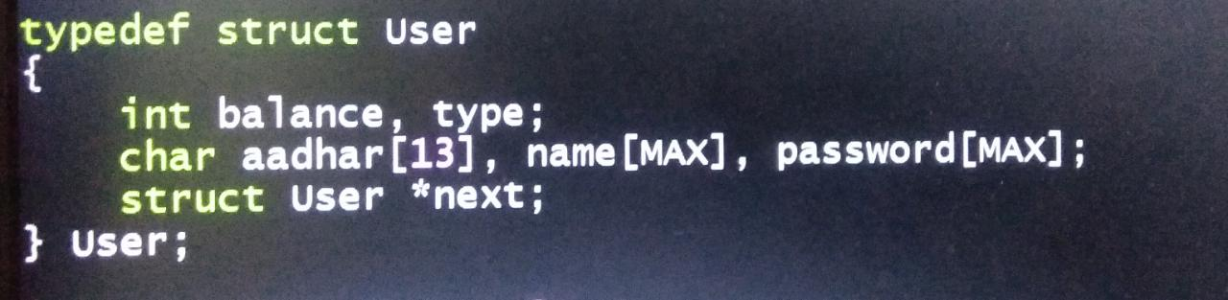
Structure user
We have a structure User and typedef it as user.

Slide 21
GITHUB LINK
https://github.com/Mannemtushara/Star-Bank-management-system

Slide 22
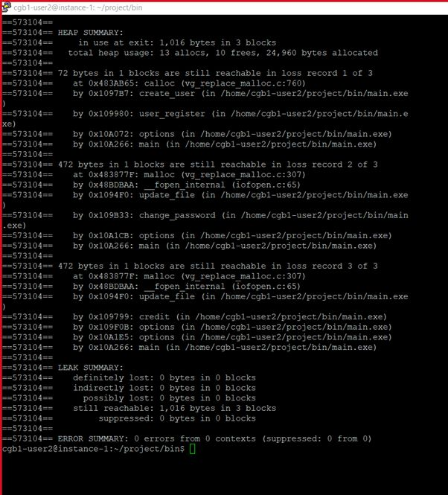
Valgrind report

Slide 23

THANK YOU

